Slide 1
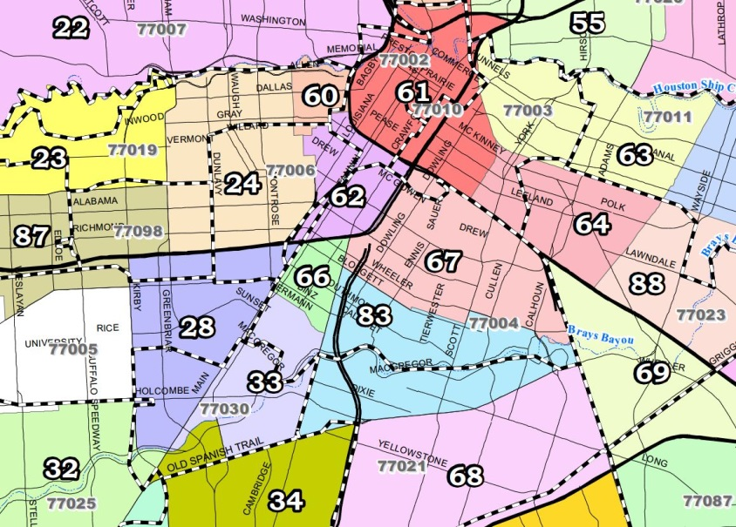
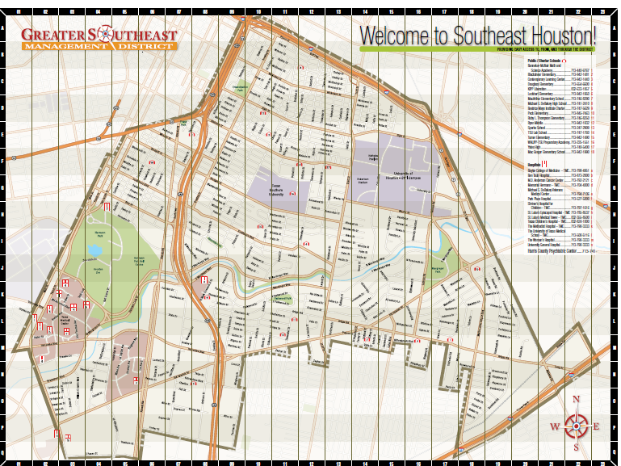
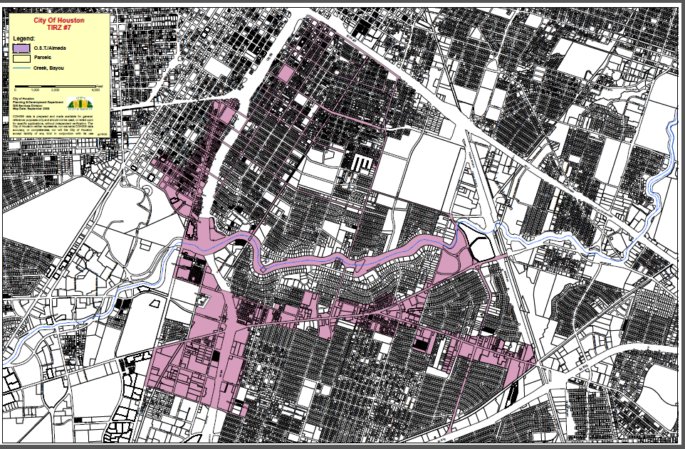
Greater Southeast Management District 19,400 acres (30.3 SM)
How It All Fits
Museum Park Super Neighborhood 359 acres (0.56 SM)
OST Almeda TIRZ
1,215 acres (1.89 SM)

Slide 2


Greater Southeast Management District 19,400 acres (30.3 SM)
Museum Park Super Neighborhood
Museum Park Super Neighborhood 359 acres (0.56 sq. miles)
OST Almeda TIRZ
1,215 acres (1.89 SM)

Slide 3
How It All Works
Funding/Founding – Taxes/Governmental
Greater Southeast Management District - 19,400 acres (30.3 SM)
Created to promote, develop, encourage and maintain employment, commerce, transportation, housing, recreation, arts, entertainment, economic development, safety, and the public welfare in the Southeast area.
2005 assessment rate was $0.1150 per $100 valuation. Assessment value for 2005 was $452,374.15. Estimated annual revenue $983,000 (2007 Service Plan) http://greatersoutheastonline.com/wp-content/uploads/2013/08/GSMD_Service_Improvement_Assessment_Plan.pdf
OST Almeda TIRZ - 1,215 acres (1.89 SM)
To create and support an environment attractive to private investment primarily along the Almeda, Old Spanish Trail, the Griggs corridors and in the Upper Third Ward area.
$39M projects in progress; $22M future planned projects.
Funded by tax increment revenue from ad valorem taxes generated from new development or redevelopment activity within the Zone.

Slide 4
How It All Works
Funding/Founding – None/Governmental
Museum Park Super Neighborhood
Geographically designated by the City of Houston. Residents, civic organizations, institutions and businesses work together to identify, plan, and set priorities to address the needs and concerns of their community.
Boundaries of each super neighborhood rely on major physical features (bayous, freeways, etc.) to group together contiguous communities that share common physical characteristics, identity or infrastructure.
The super neighborhood elects a council comprised of area stakeholders that serves as a forum to discuss issues and identify and implement priority projects for the area.
Open to all, cannot charge dues. Can become a 501c3 and raise funds.

Slide 5
Greater Southeast Management District
OST Almeda TIRZ
City of Houston
Museum Park Super Neighborhood
Museum Park Neighborhood Assn.
Museum District Assn.
Hermann Park Conservancy
South Main Alliance
Churches
Schools
Businesses
Health Care

Slide 6
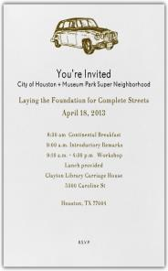

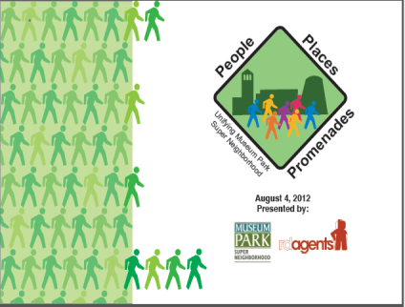

Needs Assessment and Community Engagement
Laying the Foundation for Complete Streets
Museum Park Super Neighborhood, Houston, Texas
Clayton Library w 5300 Caroline Street, Houston, TX
April 18, 2013

Slide 7
Program Elements
Pedestrian Realm
Bike Realm
Vehicle/Bus/Commercial Realm
Graphics and Signage
Sustainable Landscaping

Slide 8

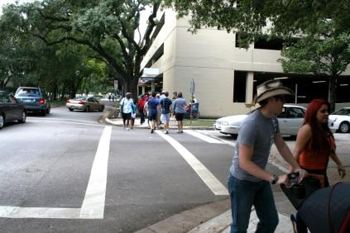
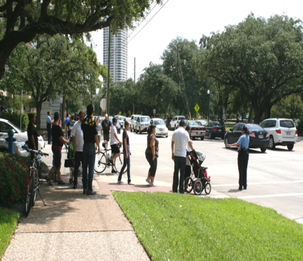
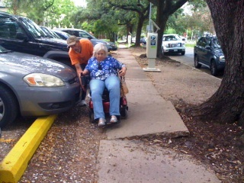


Slide 9
Museum Park Livable Centers Study - $250,000 Master Planning Grant
Houston Galveston Area Council
13 County Voluntary Organization of Regional Governments for Planning
http://www.h-gac.com/community/livablecenters/default.aspx/
H-GAC requires Local Government Sponsor for Livable Centers Grant.
Museum Park Super Neighborhood
Livable Center Study Partner
Greater Southeast Management District
Local Government Sponsor
City of Houston
Neighborhood Parking Strategies
HoustonParkingPlan.com.

Slide 10
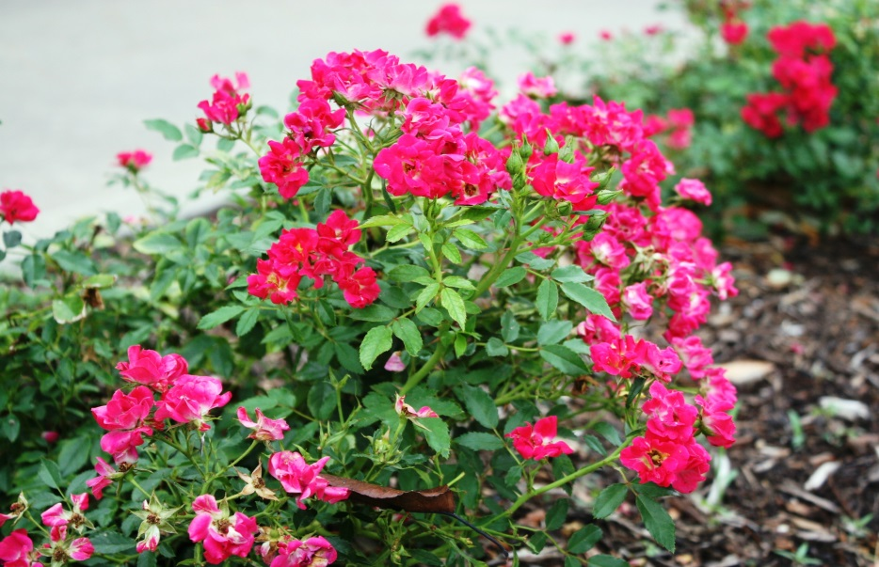
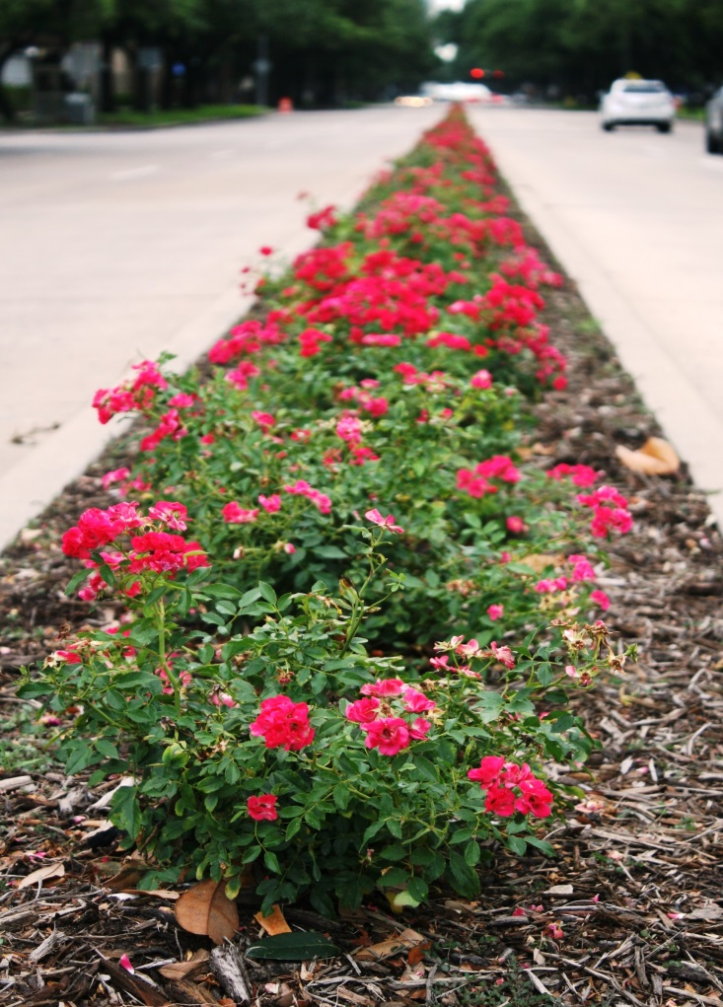
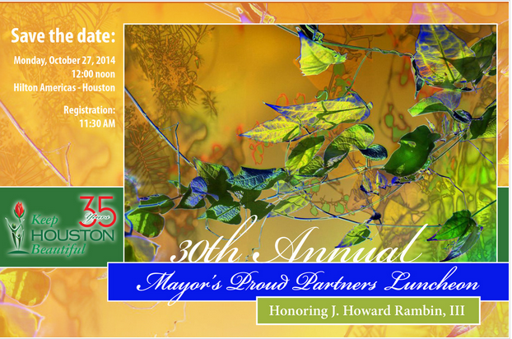
Main Street Blooms!
Mayor’s Proud Partner
2014 Certificate of Recognition
Museum Park Neighborhood Assn., GSMD, St. Paul’s Church

